Slide 1
Design Patterns
10 Jan 2014 by Deepak Naita.

Slide 2
What is Design Pattern ?
Design patterns are proven solutions approaches to specific problems.
A design pattern is not a framework and is not directly deployed via code.
Design patterns represent a solutions to recurring problems that arise when developing software within a particular context.
i.e Patterns = problems.solution pairs in a context

Slide 3
Why we need it : Usages ?
Common language for developers: They provide developers a common language for certain problems.
For example if a developer tells another developer that he is using a Singleton, the another developer (should) know exactly what this means.
Capture good practices: Design patterns capture solutions which have been successfully applied to problems. By learning these patterns and the related problem, an unexperienced developer learns a lot about software design.

Slide 4

Basic UML notations.
Association
An association represents a family of links.
An association can be named, and the ends of an association can be adorned with role names, ownership indicators, multiplicity, visibility, and other properties.
There are four different types of association: bi-directional, uni-directional, Aggregation (includes Composition aggregation) and Reflexive

Slide 5


Basic UML notations.
Aggregation
is a variant of the "has a" association relationship; aggregation is more specific than association. It is an association that represents a part-whole or part-of relationship.
Composition : stronger variant of the "owns a" association relationship; composition is more specific than aggregation. If the container is destroyed, normally every instance that it contains is destroyed as well.
Class diagram showing Composition between two classes at top and Aggregation between two classes at bottom

Slide 6
GoF Patterns
Creational Structural Behavioral
Abstract Factory Adapter Chain of Responsibility
Builder Bridge Command
Factory Method Composite Interpreter
Prototype Decorator Iterator
Singleton Façade Mediator
Flyweight Memento
Proxy Observer
State
Strategy
Template Method
Visitor
E. Gamma, R. Helm, R. Johnson, and J. Vlissides. Design Patterns, Elements of Reusable
Object-Oriented Software, Addison-Wesley, 1995.

Slide 7
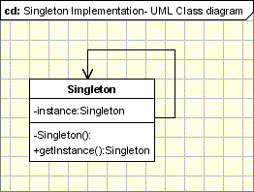
Singleton Pattern
Motivation : when its important to have only one instance for a class.
Intent :
Ensure that only one instance of a class is created.
Provide a global point of access to the object.
Implementation :

Slide 8
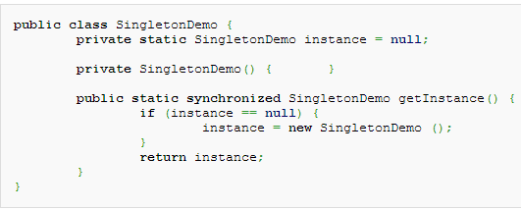
Singleton Code

Slide 9
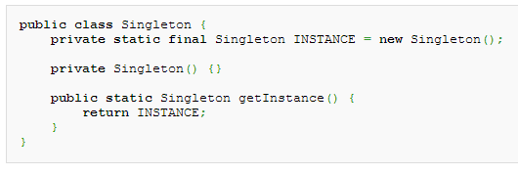
Eager Singleton
How can we make sure that ?
1. The instance is not constructed until the class is used.
2. no need to synchronize the getInstance() method, so no (expensive) locking is required.
3. instance cannot be redefined, ensuring that one (and only one) instance ever exists. (The final keyword )

Slide 10
Examples
Logger Classes
Configuration Classes
Factories implemented as Singletons

Slide 11
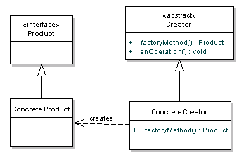
Factory Method Pattern
Intent
it's used to construct objects such that they can be decoupled from the implementing system.
creates objects without exposing the instantiation logic to the client.
refers to the newly created object through a common interface
Implementation

Slide 12

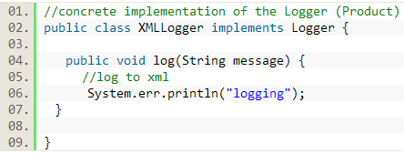
Factory code example
Concrete Product

Slide 13
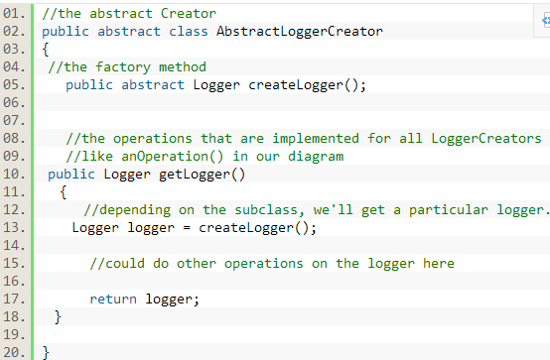
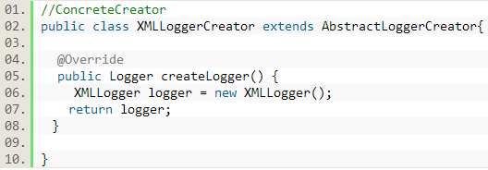
Factory code example con

Slide 14
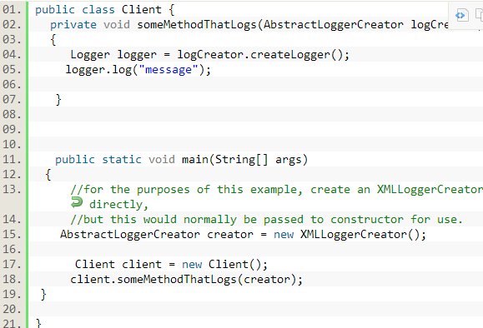

Slide 15
Structural Design Patterns
design patterns that ease the design by identifying a simple way to realize relationships between entities.

Slide 16
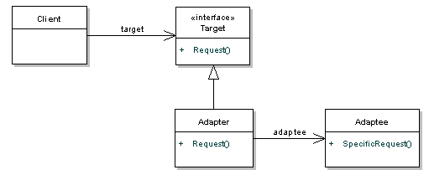
ADAPTER PATTERN
Intent
Convert the interface of a class into another interface clients expect.
Adapter lets classes work together, that could not otherwise because of incompatible interfaces.

Slide 17
COMPOSITE PATTERN
Motivation
There are times when a program needs to manipulate a tree data structure and it is necessary to treat both Branches as well as Leaf Nodes uniformly.
e.g. A program that manipulates a file system. A file system is a tree structure that contains Branches which are Folders as well as Leaf nodes which are Files..
Note : a folder object usually contains one or more file or folder objects and thus is a complex object where as file is a simple object.
When to use
can be used when clients should ignore the difference between compositions of objects and individual objects.
If programmers find that they are using multiple objects in the same way, and often have nearly identical code to handle each of them, then composite is a good choice;

Slide 18
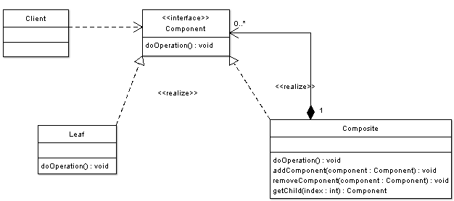
Composite Class dia.

Slide 19
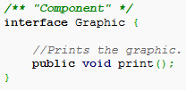
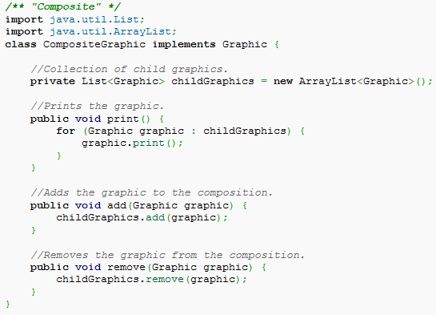
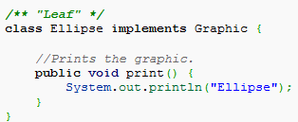
Composite design Example.

Slide 20
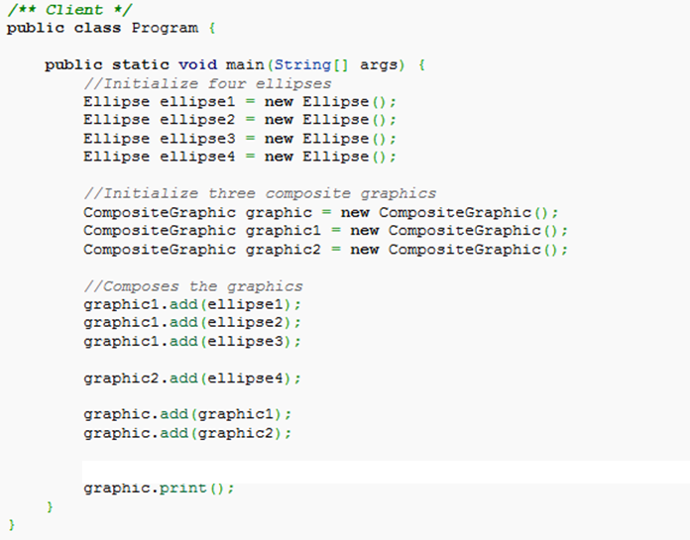
Composite design Example continued. ( what should be o/p ?)

Slide 21
Decorator
Motivation
Consider the typical example of a graphical window. To extend the functionality of the graphical window for example by adding a frame to the window, would require extending the window class to create a FramedWindow class. To create a framed window it is necessary to create an object of the FramedWindow class. However it would be impossible to start with a plain window and to extend its functionality at runtime to become a framed window.
Intent
The intent of this pattern is to add additional responsibilities dynamically to an object.

Slide 22
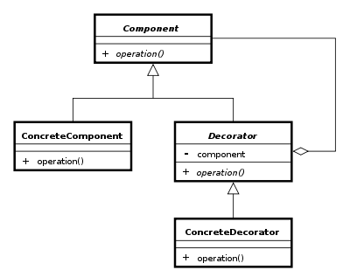
Decorator Class Dia.

Slide 23
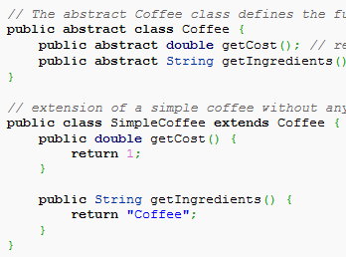
Time to make a coffee

Slide 24
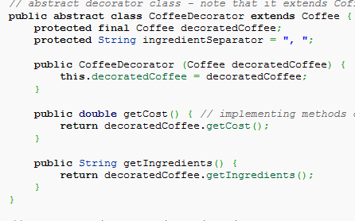
Abstract Coffee Decorator

Slide 25
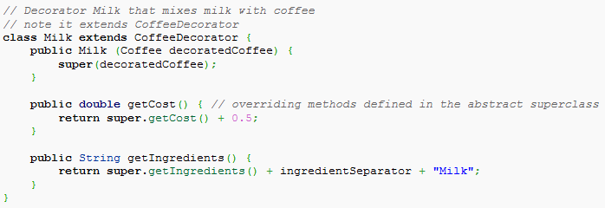
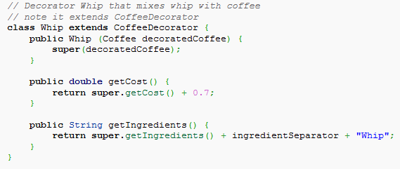

Slide 26
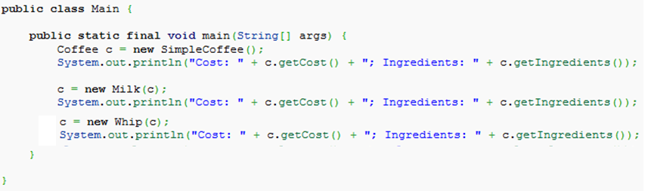
Decorator Client
What should be output ?

Slide 27
Behavioral Patterns
are design patterns that identify common communication patterns between objects and realize these patterns.

Slide 28
Observer Pattern
is the gold standard in decoupling - the seperation of objects that depend on each other.
is a software design pattern in which an object, called the subject, maintains a list of its dependents, called observers, and notifies them automatically of any state changes, usually by calling one of their methods.
Usage
mainly used to implement distributed event handling systems.
Observer pattern is also a key part in the familiar Model View Controller (MVC) architectural pattern.
Observer is a case where Java has the work done for you already in the java.util package.

Slide 29
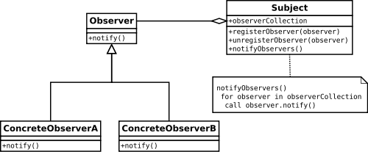
Observer Class diagram.

Slide 30
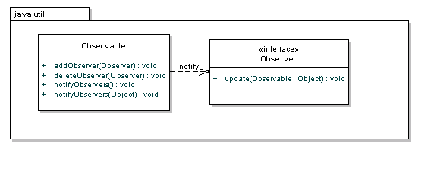
Java built in support

Slide 31
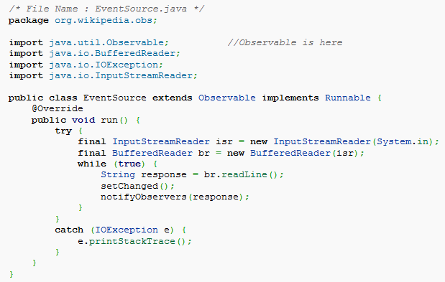
Example Code.
Very imp.

Slide 32
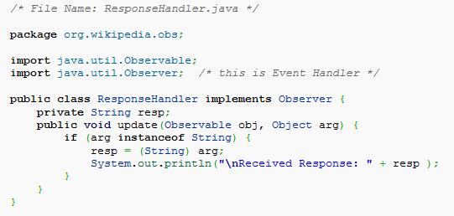
Observer …

Slide 33
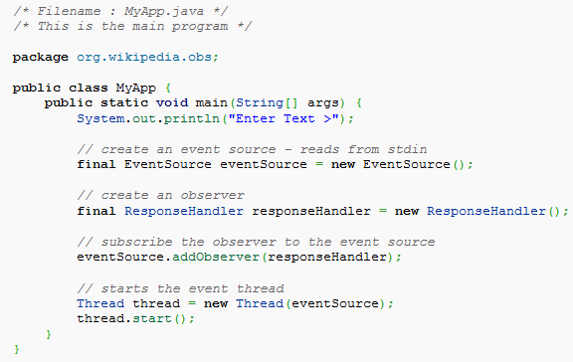

Slide 34
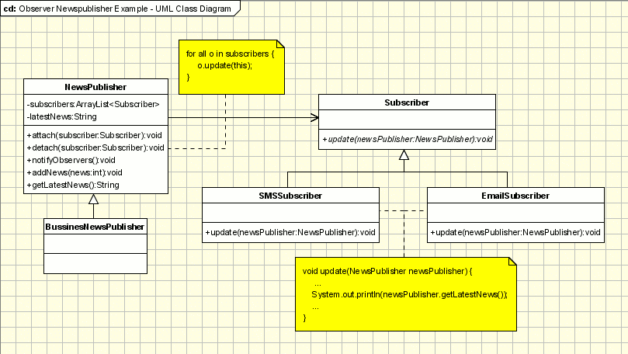
Another Example.

Slide 35
That’s it for today

Slide 36
References
http://en.wikipedia.org/wiki/Singleton_pattern
www.oodesign.com
http://en.wikipedia.org/wiki/Composite_pattern
http://www.oodesign.com/observer-pattern.html
en.wikipedia.org/wiki/Observer_pattern
http://java.dzone.com/articles/design-patterns-uncovered

